Slide 1
Mobility Network
GROUP Members
Akshada sonawAne(250254920008)
Shraddha annadate(250245920083)
Abhishek Patidar(250245920002)
Rajat Choudhary (250245920069)
Ravi tarate(250245920071)

Slide 2
Mobility Network
The Mobility Network is a comprehensive digital platform designed to streamline the management of vehicles and related operations. It enables administrators to efficiently manage vehicle information, monitor status, assign routes, and maintain up-to-date records.
Key Features:
Centralized management of vehicle details such as type, registration, status, and route assignment.
Role-based access for administrators and users.
Real-time updates and tracking of vehicle data.
Easy-to-use interface for adding, editing, and deleting vehicle entries.
This system enhances operational efficiency, reduces manual workload, and ensures accurate record-keeping, making it ideal for organizations managing transportation fleets or rental services.

Slide 3
PROBLEM DEFINATION
Managing a fleet of vehicles manually leads to inefficiencies, errors, and poor visibility into vehicle status and usage. Organizations often struggle with:
Tracking vehicle availability and maintenance status.
Assigning vehicles to routes effectively.
Keeping accurate and up-to-date vehicle records.
Lack of centralized access and control for administrators.
These challenges result in operational delays, mismanagement of resources, and increased costs. There is a need for a centralized, digital solution to automate and streamline vehicle management operations.

Slide 4
Goals and Objective
Goals and Objectives
To develop a centralized web-based system for efficient vehicle management.
To automate the processes of vehicle tracking, route assignment, and record maintenance.
To provide a user-friendly interface for administrators and users.

Slide 5
Scope
Secure User Authentication: Supports user account creation with secure JWT-based login, enabling passengers to browse available routes, select seats, and book tickets online with ease.
Centralized Data Management: Utilizes a relational database (Users, Vehicles, Routes, Tickets) to ensure consistent storage, efficient retrieval, and accurate reporting of all operations.
Role-Based Access Control: Implements permission-based access, where admins and users have different levels of control to maintain security, proper workflow, and data integrity.
Admin Functionality: Allows administrators to securely manage vehicles, monitor their status, and oversee route details through a centralized web interface.

Slide 6
System Requirement
Software Requirements
Front-end : ReactJs
Back-end : Dot NET core
Database : MS SQL

Slide 7
Hardware Requirement :-
Ram – 4 GB
CPU - Intel i5 or AMD Ryzen 5 and above
Storage: 256 GB SSD or more (for fast read/write and dev tool performance)
For Deployment (Server Hosting): Web Server: 2+ core processor, 4+ GB RAM, 50+ GB SSD storage
Scalable cloud hosting is ideal for live environments (AWS EC2, Digital Ocean Droplets, etc.)
Database Server: Can be on the same machine for small-scale; consider dedicated DB instance for higher load

Slide 8
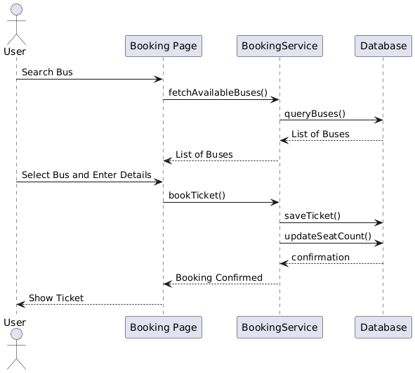
Sequence Diagram

Slide 9
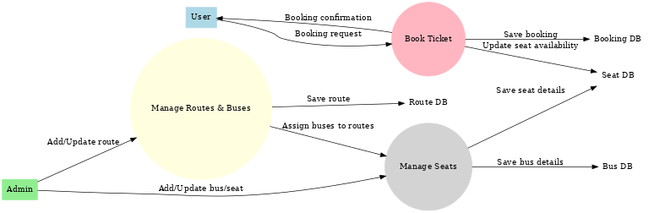
UML Diagram
DFD (Data flow Diagram)

Slide 10
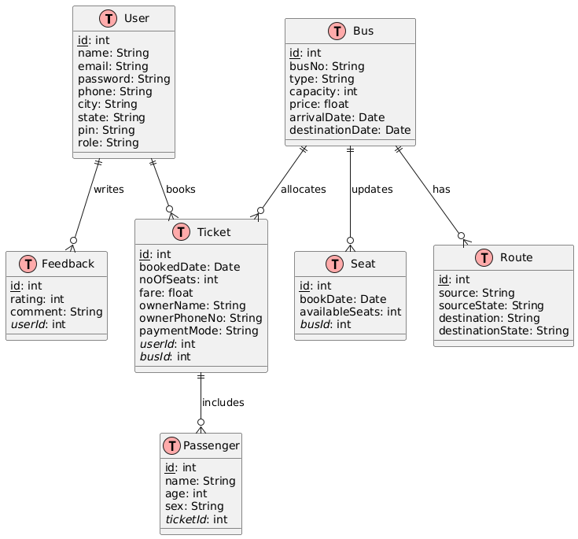
ER Diagram

Slide 11
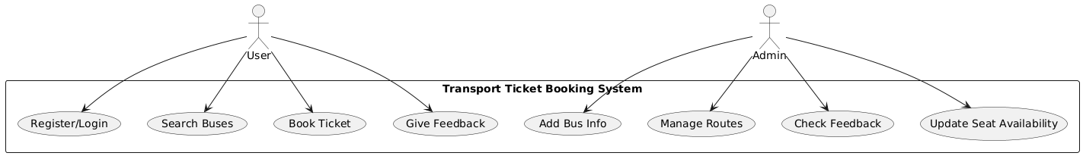
Use Case Diagram

Slide 12
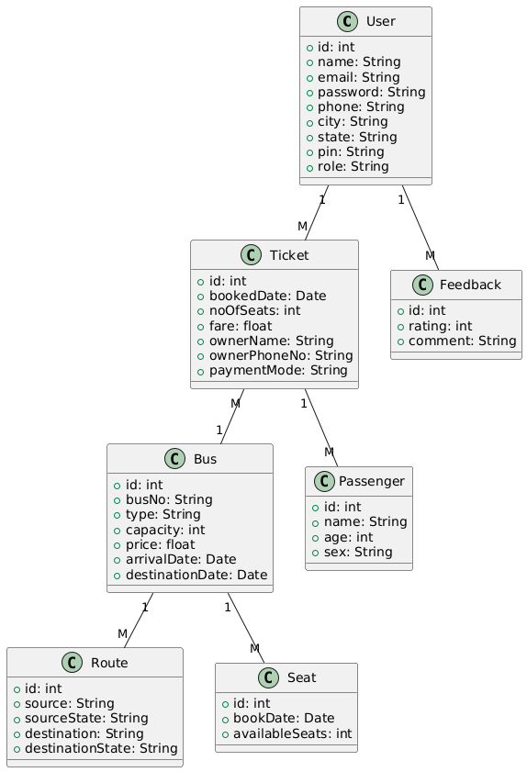
Class Diagram

